Slide 1



Overview
Premium paid by the customer is the major revenue source for insurance companies. Default in premium payments results in significant revenue losses and hence insurance companies would like to know upfront which type of customers would default premium payments.
Explore the data to identify customers with the propensity to default on the
Premiums to be paid to the Insurance company.
www.free-powerpoint-templates-design.com
Notes:
Thankyou for this oppurtunity to present my project on Insurance Premium Default Propensity Prediction.
Premiums being the major revenue source for the Insurance companies, its important that they are able to identify the customers who may have the propensity to default on the premiums.
Insurance companies would like to identify such customers, understand the reasons and make sure these cohorts pay their premiums on time.
This project will try to discover such potential defaulters, predict their behaviors, habits and patterns to eventually prescribe options & solutions to help them pay their premiums on time

Slide 2
Independent Variables to be explored
Marital Status
Premium
Nos. of Dependents
Vehicle owned
Risk Score
Premium paid Late
by 6 to 12 months
Income
Sourcing Channel
Num of Premium Paid
Accommodation
Age
Residence Area
Premium paid Late by more than 12 months
Premium Paid in Cash
Premium paid Late by 3 to 6 months
www.free-powerpoint-templates-design.com
Notes:
From our data set we will look at 15 variables which we need to explore and analyze w.r.f. to the dependent variable (Default). Of these variables 88% of data is continuous in nature.
We will need to treat these variables accordingly so as to make them robust enough to help us explore and analyse the data within.

Slide 3
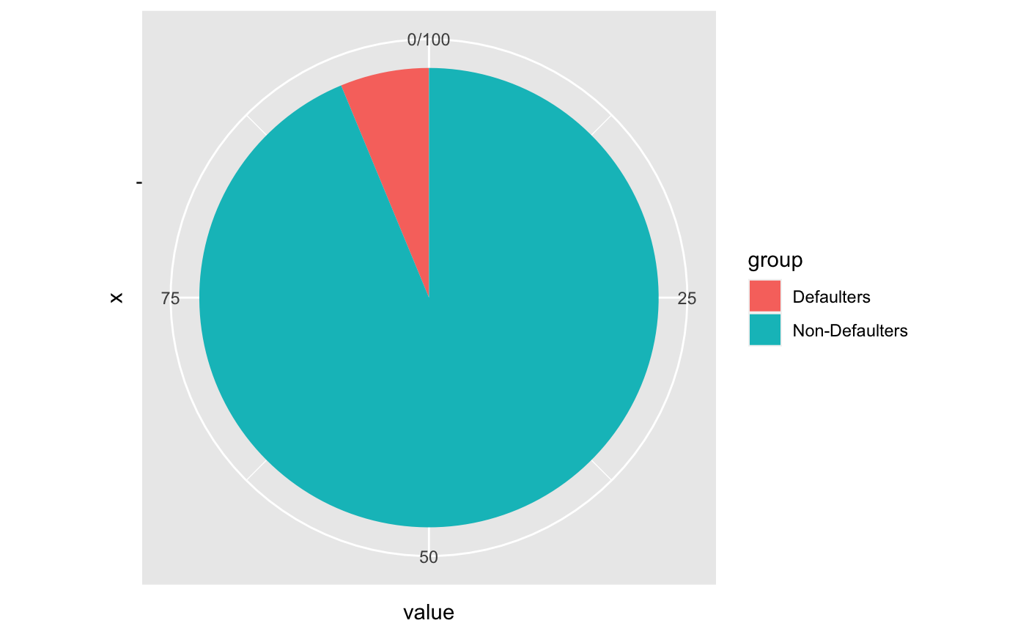
Exploring the unbalanced Data
6.25%
An unbalanced data is a challenge to explore and filter the information/cohorts especially if we have 16 variable to dig into
93.75%
Notes:
We can see that with reference to the dependent variable, the data is quite unbalance.
only 6.25% of the cohorts are defaulters who have defaulted in their last premium payment.
We need to syudy this cohort with the various variable sin our data and also understand how and when the delinquents got converted to defaulters.
We need to understand the influencers and factors for their behavior or the lack of it - to identify them appropriately to address their issues.

Slide 4
Exploring various attributes to identify the potential defaulters among the cohorts
Premium late by 6 to 12 months
Potential Defaulters
Exploring Categorical & Numerical Data to discover patterns, similarities, correlations, user behaviors, etc. to identify the potential defaulters
Age
Percentage of premiums paid by cash
Risk
Score
Premium late by more than 12 months
Income
Premium late by 3 to 6 months
www.free-powerpoint-templates-design.com
Notes:
The process will involve exploring each variable by itself and also understand the influence it may have on other variables which would help us discover the potential defaulters within such variables.

Slide 5
Solution Design
The journey of exploring the data for identifying the potential defaulters
Clean & Filter Data
Uni Variant Analysis
Bi Variant Analysis
Correlation Analysis
Building Analytical Models
Finalize/ Select
Model
Identify
Important
variables
Insights
&
Recommendations
1
2
3
4
5
6
7
8
Data Treatment
EDA
Uni Variant
EDA
Bi Variant
Correlation
Building
Basic Models, Bagging & Boosting
Best Model for Analysis
Important Variables
Findings & Solutions
Missing Value
Outlier Treatment
Variable Transformation
Adding/removing variables
Column Names
The categorical and numerical variables explored to check on aspects like the mean, median, mode, outliers and other influencing aspect of each variable individually.
see how the dependent variable (Defaulter) is behaving amidst all the categorical and numerical variables.
understand the degree of correlation and if they would be any high correlations which we need to consider for our analysis.
Model performing best of aspects like:
Confusion Matrix
Accuracy
Specificity
Sensitivity
Precision
AUC
Gini
Concordance
Discover the important influencing variables which indicate pattern, user behavior, tendency, characteristics and introspect to come out with solutions & recommendations
Long Term – Short term
One Fit or tailored solution model
Conclusion
Recommendations with some real- world example
CART model
Logistic Regression Model
Naïve Bayes
KNN
Random Forest
Gradient Boosting
XG Boost
www.free-powerpoint-templates-design.com
Notes:
Our solution design will involve a step - by step process which will begin with
1- cleaning and treating the data set for exploring and analysing. We will treat the data set for any Missing Values, Outliers Treatment, transforming variables for our benefit, adding or removing variables etc.
2- After which, we will next perform an Exploratory Data Analysis which would involve a
Uni Variant analysis on the categorical and the numerical variables to check on aspects like mean , median, outliers and other influencing aspect of the variables.
We will conduct a Bi Variant Analysis and see how the dependent variable is behaving amidst the categorical and numerical variables.
3- We will explore each categorical and numerical variable to discover patterns, similarities, correlations. In case of any high correlation between any variable we will need to account it and accordingly treat them for further analysis.
4- We would then want to work on building some analytical models to analyse our dataset.
To do that we will first create a Train Set & Test Train from our original data set for validating and evaluating our models.
Once we create the Train & Test Data we will want to treat the Train Data set for the unbalanced nature of the data so that the bias does not influence the outcome in a wrong way. For doing that we will treat the Train Data with SMOTe technique.
5 - we will then build various models ranging from basic logistic regression model, decision tree models, naive bayes, KNN, to bagging model like Radom Forest and boosting models like Gradient Boosting & XG Boost.
6- We will then compare all the models on various parameters of influence and importance to come up with the best model for our analysis.
7 - we will in the process identify the most influencial variables to discover potential defaulters.
8 - lastly we will get insights and come out with recommendations and solutions to our problem.

Slide 6
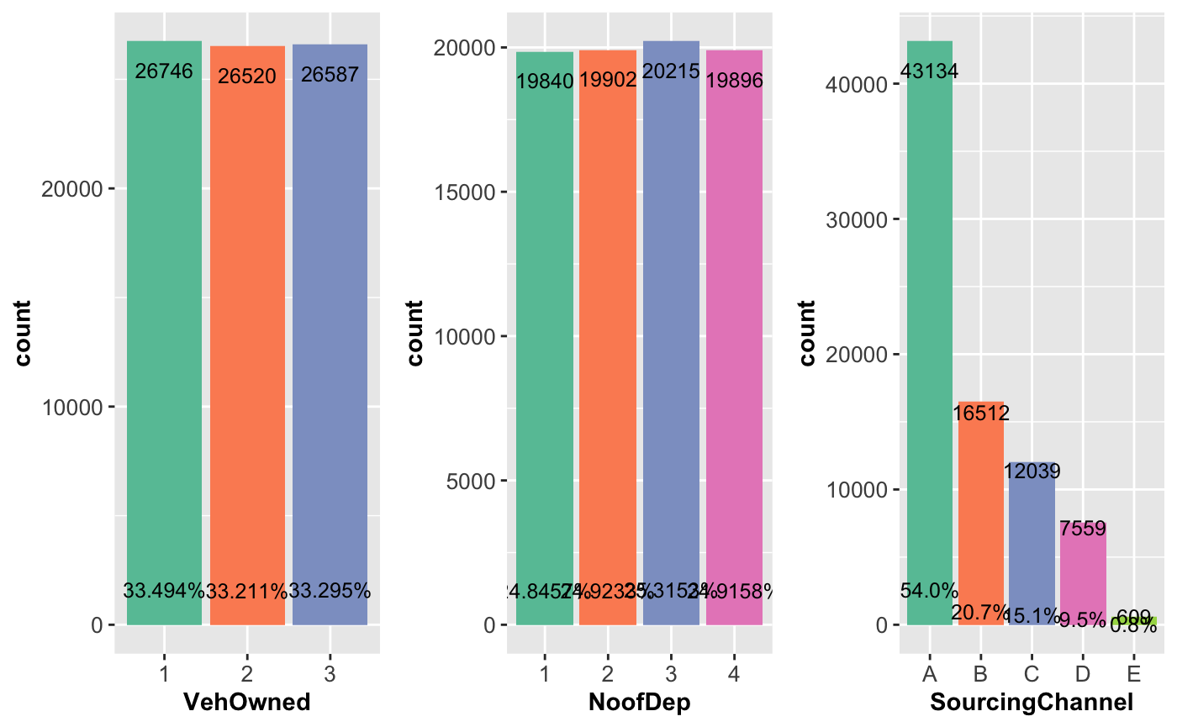
Uni Variant Analysis of Categorical variables
Notes:
We don't see much difference or influences in these categorical variables. All sees to be evenly distributed.
though - Sourcing Channel A dominates among all Channels with more than double the counts of any other sources.

Slide 7
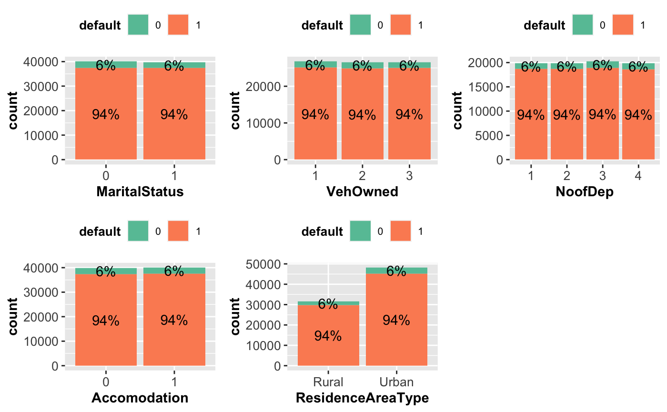
Bi Variant Analysis of Categorical variables
Notes:
We don't witness any significantly different influencers in these categorical variables

Slide 8
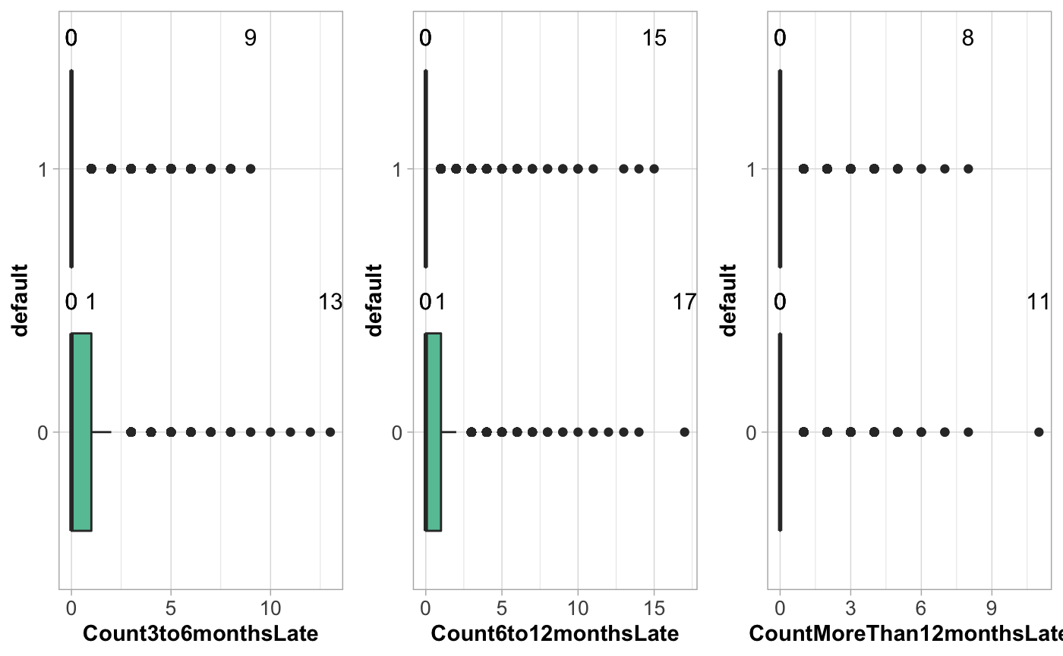
Bi Variant Analysis – old vs new defaulters
Identifying the pattern of the defaulters with the cohorts who have been late in paying their premiums by
- 3 to 6 months
6 to 12 months
More than 12 months
Notes:
We see the default variable showing similarities in the 3 to 6 and 6 to 12 delinquent cohorts. We will need to analyze deeper to see how these variable to help identify a pattern and correlation with each other if any

Slide 9
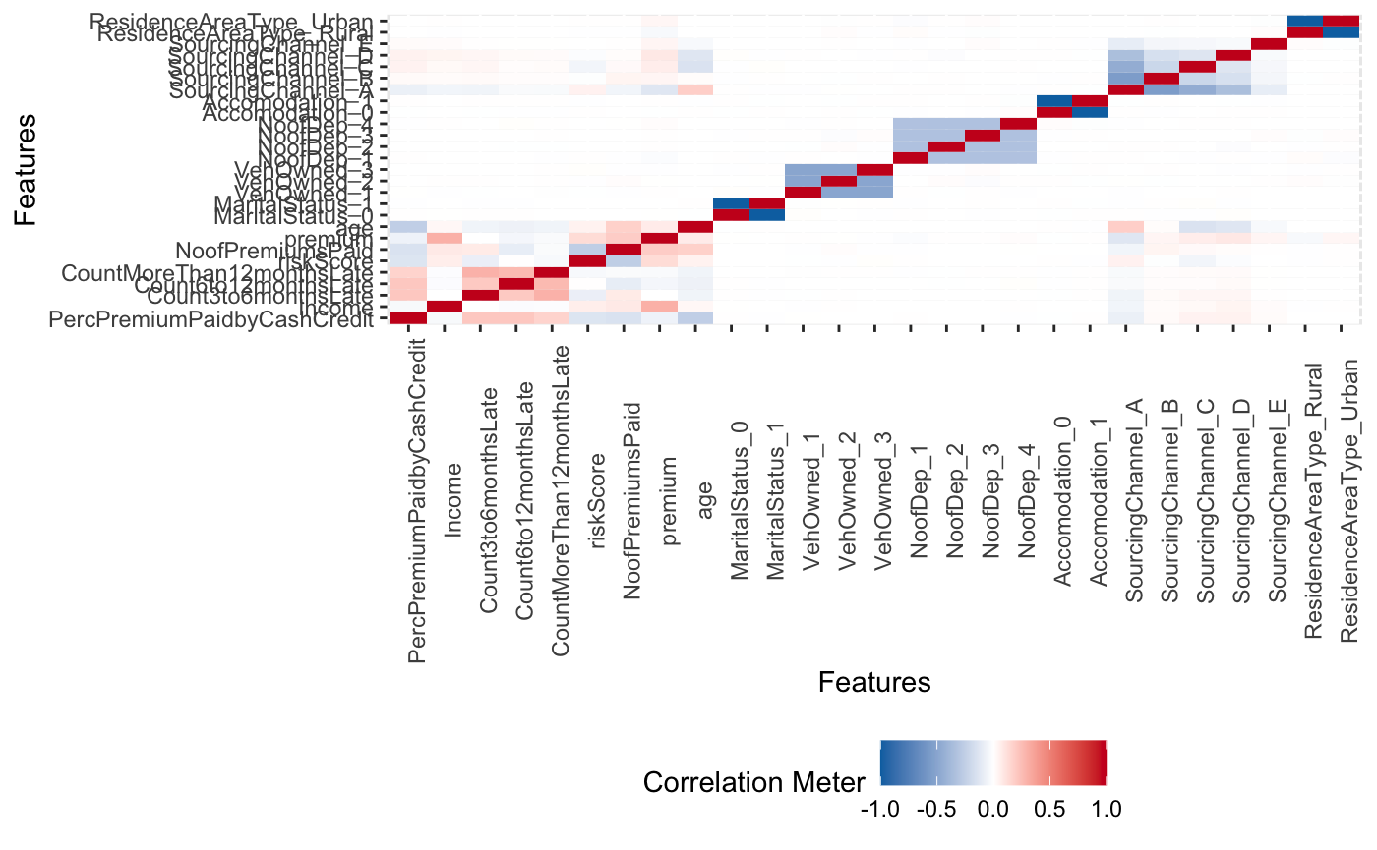
Correlations among all variables
No High Correlation among any variables
Notes:
No high correlation witnessed among any variables. Comparatively a correlation is seen between
Income & Premium
followed by Premium Paid in Cash with all the 3 late counts for paying premiums,
and between each of the three late premium payment variables.
Interestingly - Age and Sourcing Channel A is showing some correlation as well.

Slide 10
Analytical Models
Basic Models
Will apply a Supervised Machine Learning Technique for a Descriptive, Predictive & Prescriptive Analysis
Decision Tree
classification method
Nearest neighbors
Regression
Naïve Bayes
CART
Logistic
Regression
KNN
Supervised Machine Learning Technique
Probability of the given feature vector being associated with a label
Built a CART model on the train data. -- create CART model 1 & validate for accuracy.
-- Tuning the model: further tune the model for further accuracy
Model Validation: validate the new model
Model Evaluation: evaluate both the models on the test data & compare their accuracy.
+ Tune the model and prune the tree, if required.
+ Test the data on test set.
Logistic function to model the conditional probability
classify new data points based on similarity measure
the algorithm expects the features to be independent which is not always is the case.
In the case of binary classification the probability of defaulting premiums and not defaulting premiums will sum up to 1
Classification is done by a majority vote to its neighbors. The data is assigned to the class which has the nearest neighbors.
As you increase the number of nearest neighbors, the value of k, accuracy might increase.
www.free-powerpoint-templates-design.com
Notes:
After creating the Train & Test Data - and SMOTING the train data we
apply a supervised machine learning technique and create
1) Cart DT - a classification model which splits data features into nodes until a final decision output is made
2) LOGISTIC REGRESSION model- used to classify binary outputs based on their likelihood
3) NAIVE BAYES - classification technique which applies probability to an event based on the knowledge of factors that might affect the event
4) KNN - which increases accuracy as the nos. of nearest neighbors increase

Slide 11
Analytical Models Bagging & Boosting
Process will involve creating a Train & Test Data set from the original data set. The training data set will be used to validate each model and the same will later be used to evaluate the model on the test data set.
Boosting
Bagging
Gradient
Boosting
Boosting
Random
Forest
X G Boost
machine learning boosting
It relies on the intuition that the best possible next model, when combined with previous models, minimizes the overall prediction error.
an ensemble method that trains several decision trees in parallel with bootstrapping followed by aggregation
Efficient to the Gradient Boosting
Extreme Gradient Boosting (XGBoost) is similar to gradient boosting framework but more efficient. It has both linear model solver and tree learning algorithms. What makes it fast is its capacity to do parallel computation on a single machine..
-- Incase there is no significant improvement in the CART model from the baseline model, we build the Random Forest.
-- Tune the Model
-- Model Validation: validate the new model
-- Model Evaluation: evaluate both the models on the test data & compare their accuracy.
www.free-powerpoint-templates-design.com
Notes:
5) BAGGING TECHNIQUE - RANDOM FOREST : classification model which improves accuracy of a simple DT by generating multiple DTs & taking majority vote to predict output
6) BOOSTING - Gradient Boosting - classification technique which generates DT sequentially where each tree focuses on correcting the errors of the previous model
7) XG Boost its a more efficient version of Gradient boosting.

Slide 12
Confusion Matrix
Indication towards extracting “defaulters’ & ‘non-defaulters
CART MODEL 1 | Defaulters | Non-Defaulters
Defaulters | 173 | 826
Non - Defaulters | 218 | 14753
CART MODEL 2 | Defaulters | Non-Defaulters
Defaulters | 0 | 999
Non - Defaulters | 0 | 14971
Naïve Bayes | Defaulters | Non-Defaulters
Defaulters | 0 | 3
Non - Defaulters | 999 | 14968
Logistic Regression | Defaulters | Non-Defaulters
Defaulters | 122 | 96
Non - Defaulters | 877 | 14875
KNN | Defaulters | Non-Defaulters
Defaulters | 98 | 901
Non - Defaulters | 103 | 14868
Gradient Boosting | Defaulters | Non-Defaulters
Defaulters | 147 | 852
Non - Defaulters | 126 | 14845
Random Forest 1 | Defaulters | Non-Defaulters
Defaulters | 159 | 840
Non - Defaulters | 154 | 14817
Random Forest 1 | Defaulters | Non-Defaulters
Defaulters | 2 | 997
Non - Defaulters | 0 | 14971
XG Boost | Defaulters | Non-Defaulters
Defaulters | 113 | 886
Non - Defaulters | 81 | 14890
Notes:
A Confusion Matrix shows efficiency of the models in identifying the predicted & actual "defaulters' & "non-defaulters". We see CART, RF & Gradient Boosting models predicting maximum defaulters

Slide 13
Overview: Models Analysis
Models | Accuracy | Sensitivity | Specificity | Precision | KS | AUC | Gini | Concordance
Cart Model 1 | 0.93 | 0.92 | 0.01 | 0.92 | 0.5 | 0.80 | 0.03 | 0.17
Cart Model 2 | 9.374452e-01 | 9.374452e-01 | 0.00 | 9.374452e-01 | 0.00 | 5.0 | -2.27 | 0.00
Random Forest 1 | 0.93 | 0.92 | .009 | 47.33 | 0.50 | 0.81 | 0.05 | NaN
Random Forest 2 | 9.375704e-01 | 9.375704e-01 | 1.252348e-04 | 7.48 | 5.111567e-01 | 8.177137e-01 | 1.159270e-02 | NaN
Logistic Regression | 0.93 | 0.93 | 0.007 | 0.93 | 0.5 | NA | 0.03 | NaN
Naïve Bayes | 0.93 | 0.93 | 0.00 | 0.93 | 0.51 | NA | 0.0001 | NaN
KNN | 0.93 | 0.93 | 0.006 | 73.97 | 0.39 | 0.72 | 0.043 | NaN
Gradient Boost | 0.93 | 0.92 | 0.009 | 0.92 | NA | 0.82 | NA | NaN
X G Boost | 0.93 | 0.93 | 0.007 | 0.93 | 0.51 | 0.82 | 0.02 | NaN
Notes:
Compare all models on various parameters:
Accuracy - tells the proportion of Defaulters & Non Defaulters in the data set
Sensitivity - ability to designate a defaulter as positive.
Specificity - ability to designate a non-defaulter as negative.
Precision - Positive Prediction Value - probability of how often a +ve test represents True +ve
KS - returns a p - value (which has the same interpretation as other p -value) if p value is less than the significance level we reject the Null Hypothesis that the sample comes from a specific distribution. Here we see all model reject the Null Hypothesis
AUC ROC is a performance measurement at various thresholds
higher AUC means the performance of that model is better at distingusing the +ve & -ve class
Gini co-efficient is a good indicator of inequality i.e. distribution of defaulters across population.
level 0 indicates absolute equality
CART Model 1 gives the best result in Specificity compared to other models.. On the other attributes too it performs better than or as good as the other models.
Specificity is important for us as an attribute because our positive class is set at 1 i.e. non-defaulter

Slide 14
Most Important & Influencer variables
Late in Payment of Premiums
Late by 3 to 6 Months
Late by 6 to 12 months
Late by more than 12 months
Important
Influencing
Variable to deep dive
Paying Premiums in Cash Credit
Cash in hand to pay Premium is a major attribute for paying Premiums
Risk Score
High Income = High Risk -Score = Low Defaulters
Income
High Income = Low Defaulters
Late in Payment of Premiums
Paying Premium in Cash
Risk Score
Income
www.free-powerpoint-templates-design.com
Notes:
The variable influencing majorly to identify potential defaulters include the above 7 attributes.
Understanding the factors our recommendations will revolve around solutions towards these attributes

Slide 15


Key Findings
01
Looking at customers who are late in paying premiums in all 3 categories. They seem to follow a common pattern. Also, the risk score is a good indicator here as low risk score customer tend to have defaulted on the payments.
02
Paying Premiums in Cash Credit seems like a stumbling block for some customers. Look at solutions to manage this issue by creating options towards offering insurance types and subsequent premiums.
03
Income seems an influencing factor. We comparatively see lesser defaulters amidst the higher income bracket
04
Interactive – Engaging – Incentive based options
05
Flexible, customized, tailored payment options for eligible customers
www.free-powerpoint-templates-design.com
Notes:
Commonality in the 3 late payment categories
Income is an important variable which. Influences ”paying of premium’, “Paying of premium in cash”, “risk score’
Need to come with a solution which solves the “payment with cash” and flexibility of product, policy & premiums around the Income – will discuss this is next slides.

Slide 16
Recommendation
You can download professional PowerPoint diagrams for free
Short term vs Long Term Options
Rather providing a long term offering, what needs to be offered would be a solution which addresses the current issue in hand and something that will rightly fit in their scheme of things.
A comprehensive but simple product which is easy to issue and pick needs to be developed.
01
Is capability to make Payment the only reason to Default?
02
Convenience, simplified product, easier issuance of insurance could at times solve the lethargy of not prioritizing the payments towards your premiums.
Options for cashless service, credit service, EMI offerings, deferring options (case basis), etc. can be offered to pay premiums timely
Solution bases customized offering (Sachet, Bouquet, etc.)
03
Relevant and simpler options could at times be easier to pick up especially during the challenging times like the pandemic when work, business, jobs and earnings are a challenge.
01
02
03
04
Interactive – Engaging – Incentive based options
04
Coming up with easy to adapt and engage programs for the customers by which one can achieve solutions for the insurer and the insured.
We need to keep in mind the current economic fallout due to the pandemic and the impact it has had on jobs/ business/income when we come our with solutions for the payments of the premiums.
www.free-powerpoint-templates-design.com
Notes:
We need to keep in mind the current economic fallout due to the pandemic and the impact it has had on jobs/ business/income when we come our with solutions for the payments of the premiums.
Solution need to be from the customers perspective and not the insurance company.
Solutions short term options to manage current issues and which fits in the scheme of things. A simple & basic product – easy to pick and issue could be a workable solution
Is “capability to pay” the only reason for defaulting? – user behaviour, habits, priority, complexity of issuance/payment could be a hurdle – simplified and easy issuance and options towards payments like EMI, monthly , quarterly, bi – annual kind of options as per the requirement and amount of the premium.
Solution based simpler product offering rather than an elaborate all inclusive ….. Come up with customised , tailored, essential – basic product with affordable premiums attached …. Easy to pay options and affiliations with various fintech companies like payment platforms, CC, banks, etc. to have a ecosystem created where adoption of such insurance becomes as easy as managing essentials.
A interactive, customer engaging – incentive based option is shared here which needs to have a customer mindset changed for his/her own well being and benefit

Slide 17




Changing the Customer Mindset
outlook towards priority for health – insurance – paying premium
Incentivize customers for having health priorities
* Solutions should be from customer perspective and not a push to simply collect premiums.
* Look at the issues from customers stand-point
* Push to make the customer a healthier person which has advantages for the individual and the insurer
*Develop products, schemes, programs to incentivize those who maintain a regular healthier lifestyle
Cashless
alternatives
Convenience
to
participate
incentives
Interactive
Cash benefit programs which would include lesser premiums as per healthier lifestyle, deferred period of payments for customers showing a healthier trend.
Regular incentives on milestones which offers discounts, freebies, add-ons for encouraging fitness on a daily basis.
Easy to adopt solutions (like loading app on customer’s handset) and interactive options for easy participation to keep customers interested, engaged and encouraged.
www.free-powerpoint-templates-design.com
Notes:
To make an alternative lifestyle and payment alternative – create an ecosystem of inclusive participation and incentised options for making the insurer realize importance of health and fitness.
A healthy insurer is what a insurance company will like to deal with and be flexible with. Create such aware and conscious customers by providing them options which are easy for their payment capability, convenient for participating towards the incentivized based option.

Slide 18
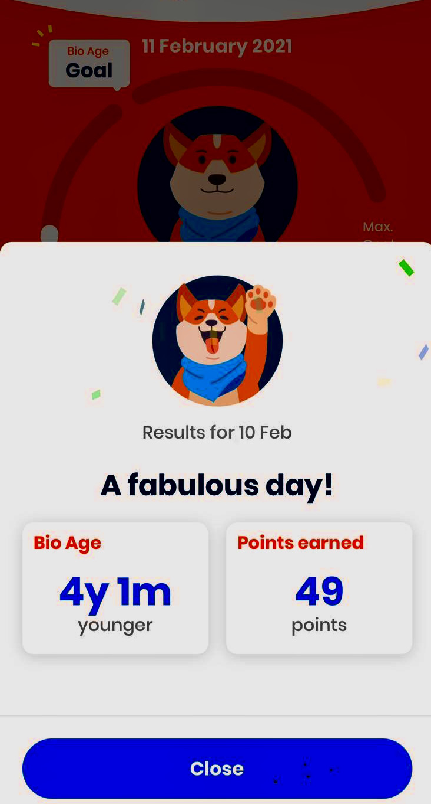
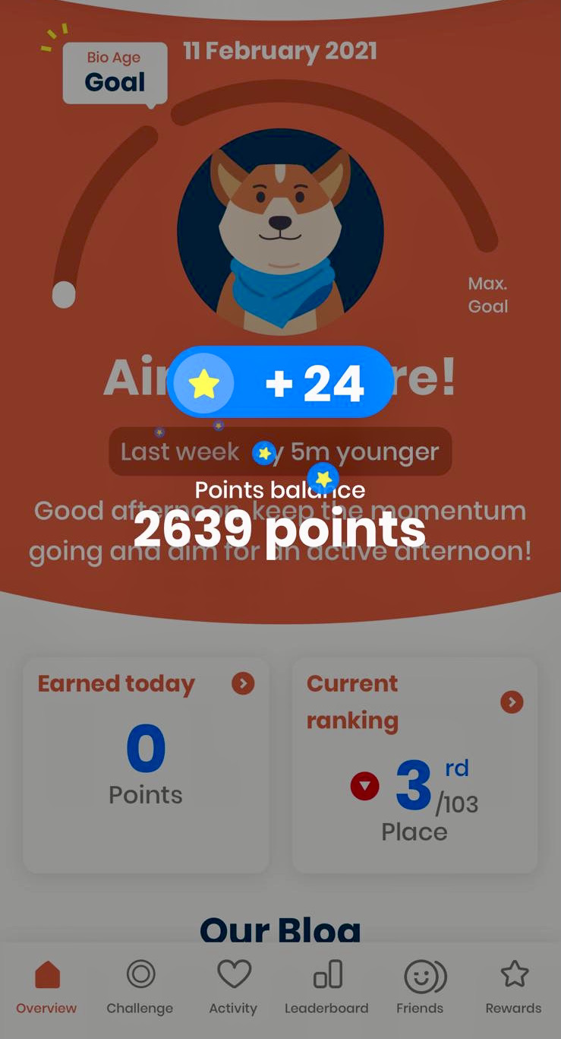
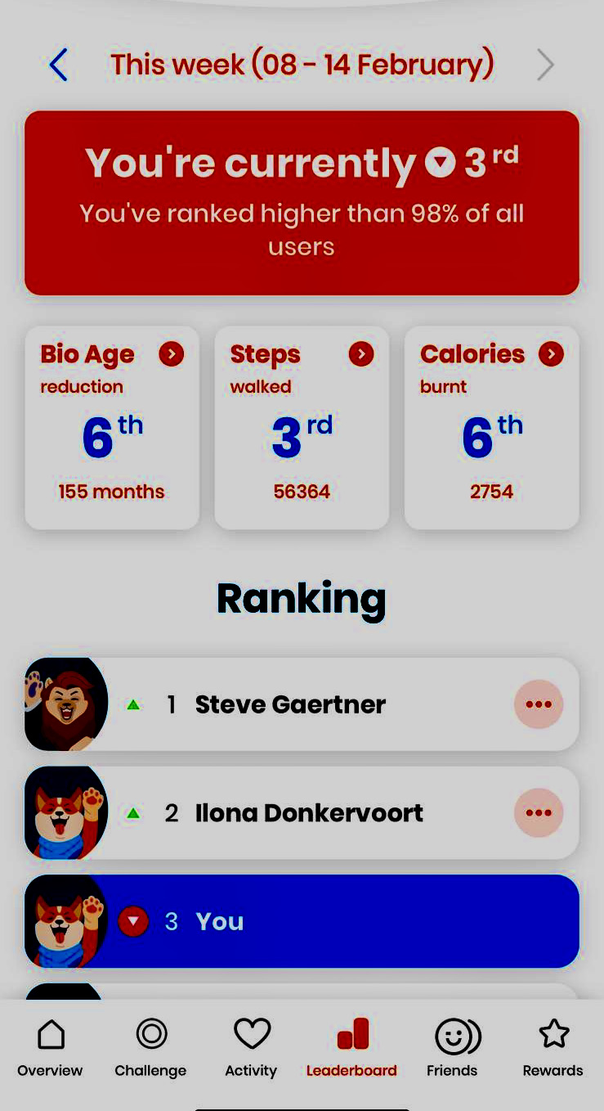
Recommendation Example
Advantageous for both insurer & the insured
the rewards and incentives on a regular basis is a significant gain plus staying in great shape keeps you positive to manage life
A Vitality Fitness App to keep the user engaged with regards to his/her physical activities like walk, jog, sleep, etc.
Incentivize the user with a lesser premium amount by basis of their bio age fitness level
Notes:
1) A Vitality Fitness App to keep the user engaged with regards to his/her physical activities like walk, jog, sleep, etc. The App will calculate the fitness level of the user and accordingly offer incentives and offers like discounts & freebies
2) This screenshot shows the user being fit and active. Such result could be reasons to incentivize the user with a lesser premium amount by calculating their bio age fitness level
3) Regular activity, monitoring and motivation encourages the user to stay involved and achieve better because the rewards and incentives on a regular basis is a significant gain plus staying in great shape keeps you positive to manage life.
4) A healthy and active customer is something that an insurance company would like to keep insured and engaged

Slide 19
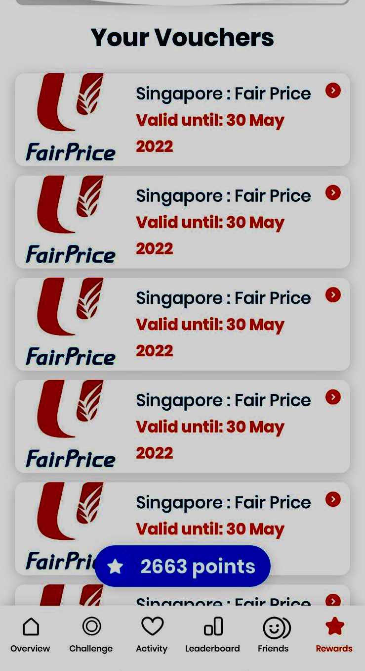
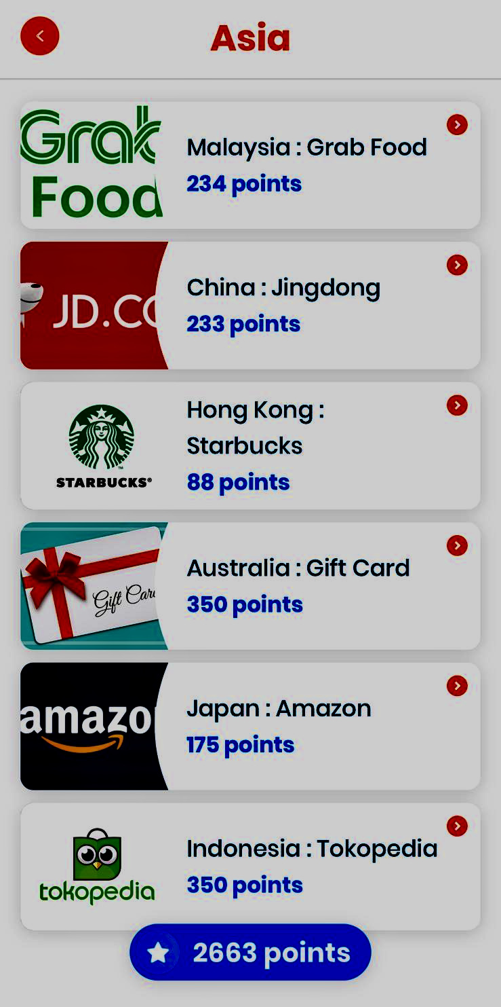
Recommendation Example
Benefits * Incentives * Rewards * Recognition * Discounts * Deferred payment options
Deferred period options for payment of premium**
More active and healthy = more attractive offerings on premiums**
a healthier customer = benefits from other financial & professional service**
**All stakeholders together create a ‘value prop” with customer at the center**
Variety of benefits ranging from daily refreshments, daily rides, vouchers for e-shopping
Groceries shopping vouchers. The more you stay fit – the more discounts you earn
Notes:
Deferred period for payment of premium (insurer is flexible with a healthy insurer and can afford to provide options for payment)
Rewarding with lesser premium for staying healthy and active . More active and healthy = more attractive offerings on premiums
A healthy fitness score card shared by insurer with other service providers like financial institutions, education, jobs & professional service . Such institutions would be more forthcoming to be engaged and offer services like loans etc. to a healthier customer as chances of recovering from a healthy person is always more and makes business sense.
All stakeholder could come together to create a “Value proposition” by keeping the customer in the center of things and create offerings in such a fashion that the customer finds ”value” in more more ways than one to stay active and healthy for self and his/her dependents.

Slide 20
Thankyou
… end of presentation

